Slide 2
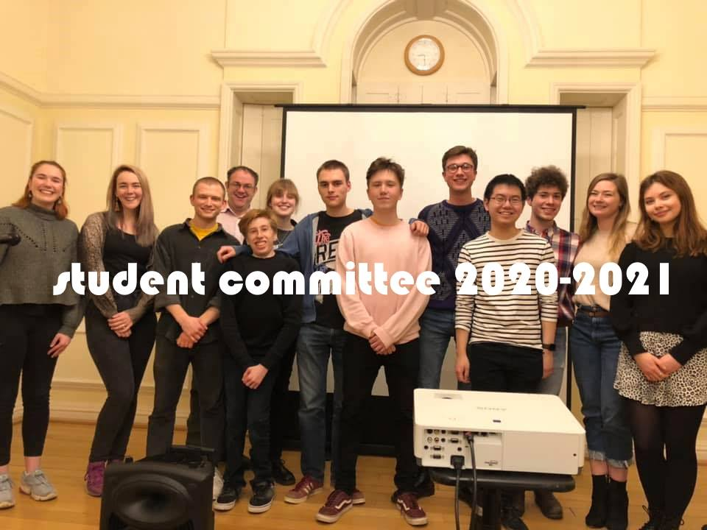

Slide 3
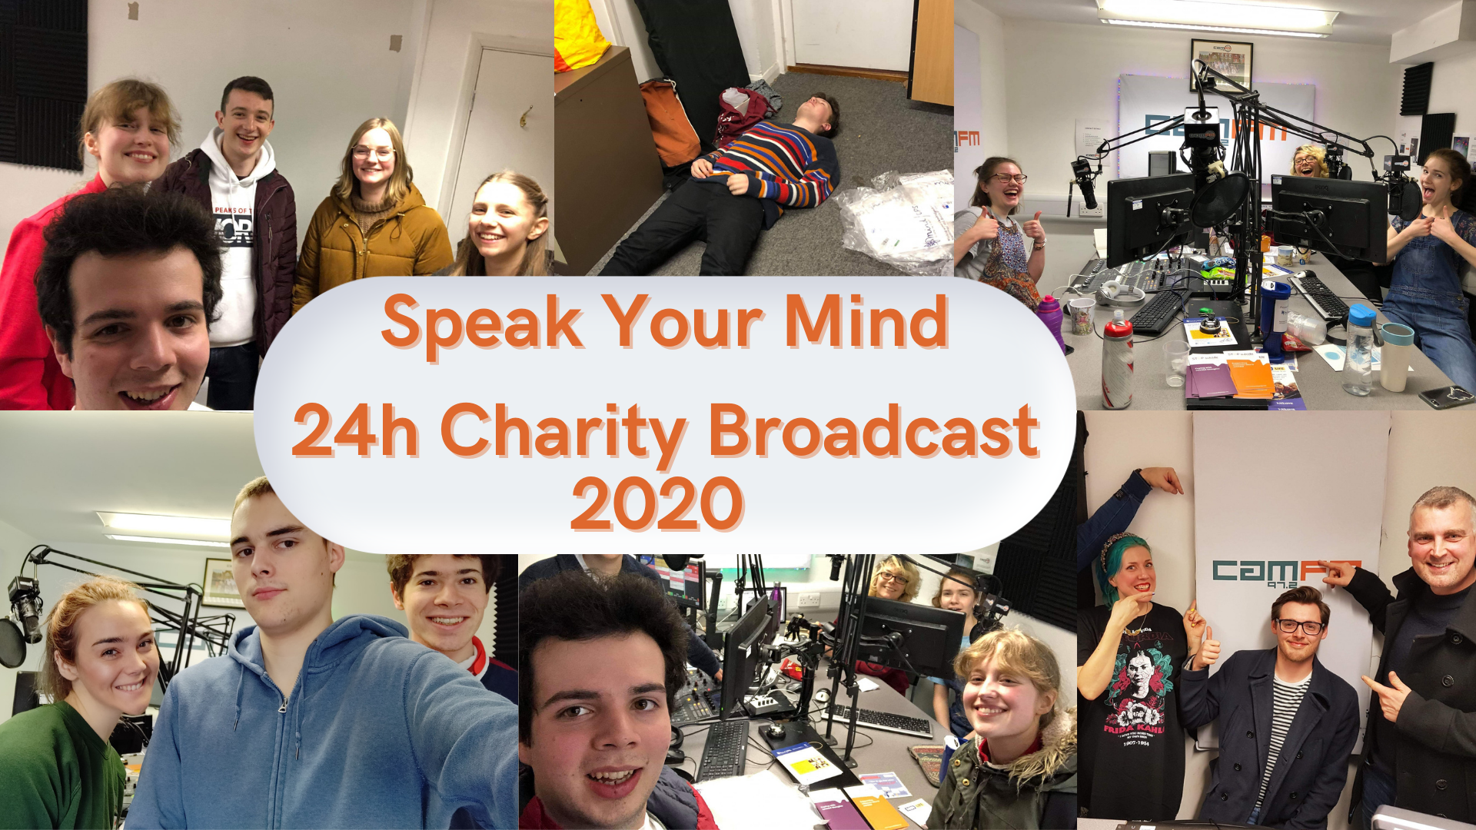
£841 raised!

Slide 4
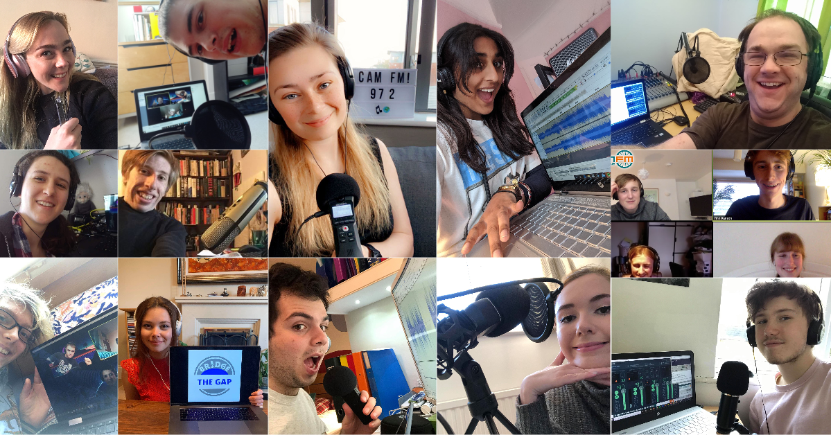
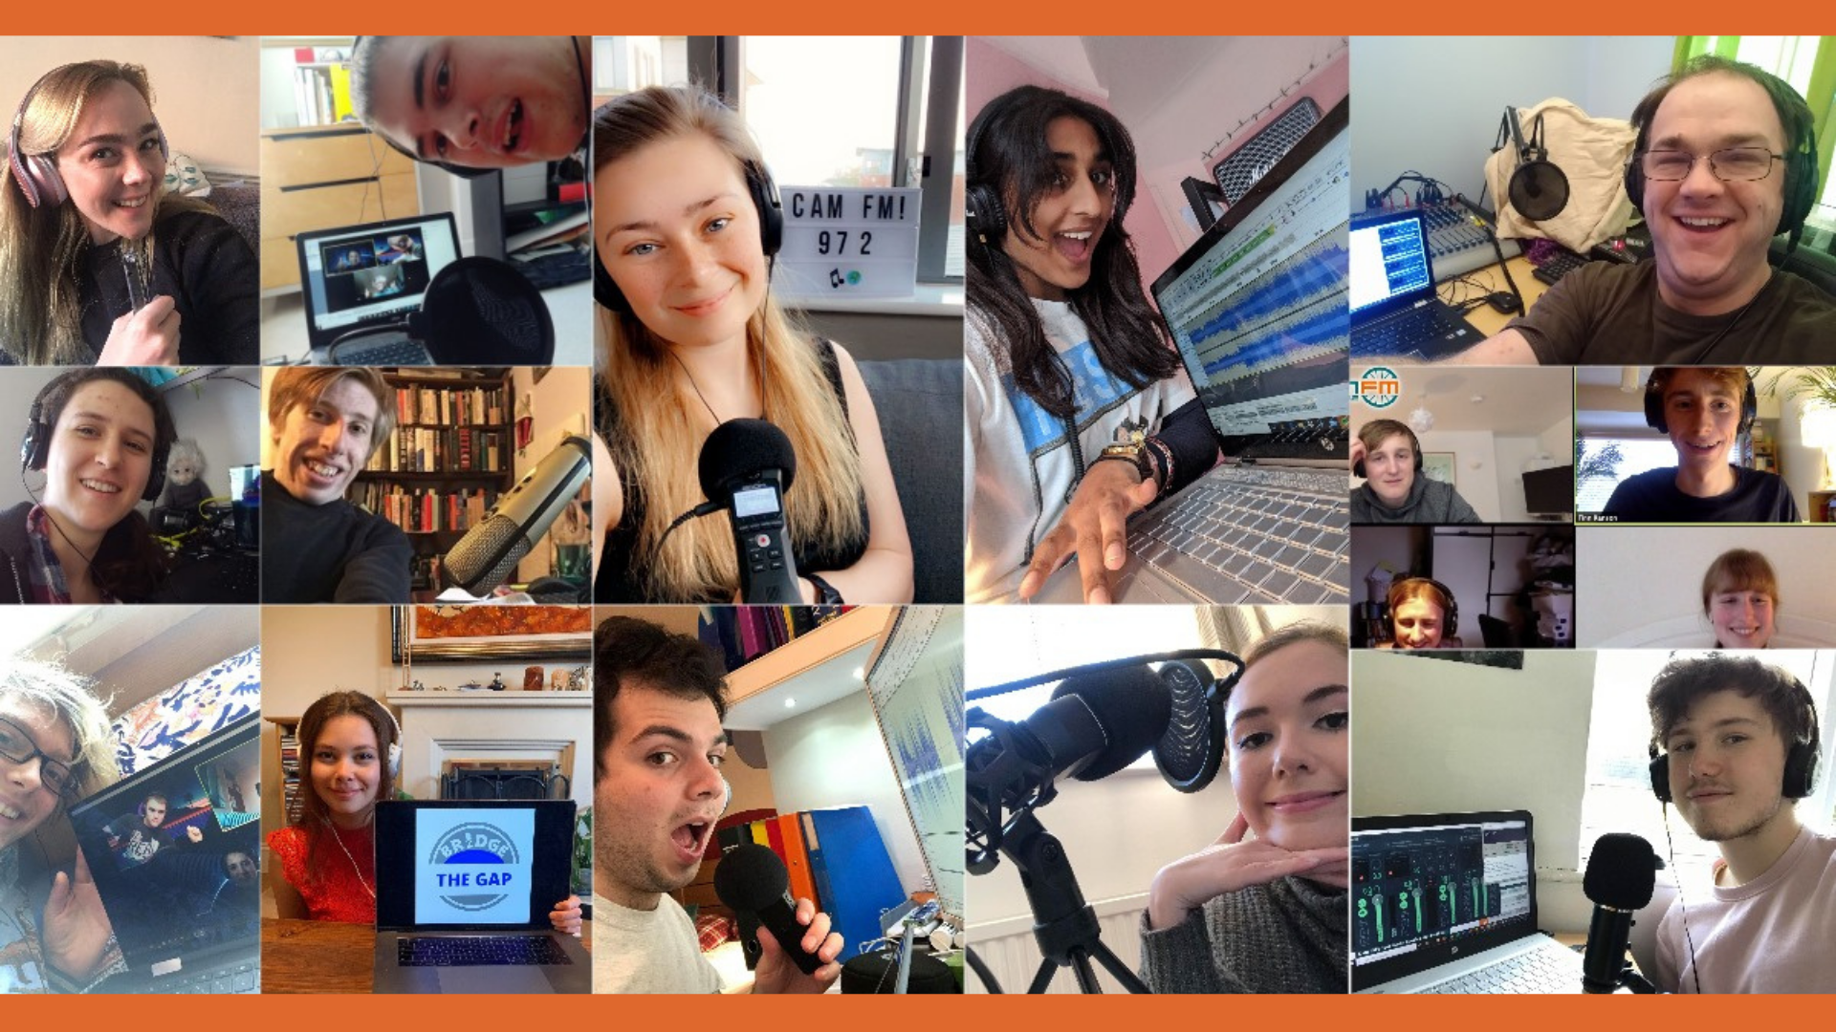

Slide 6
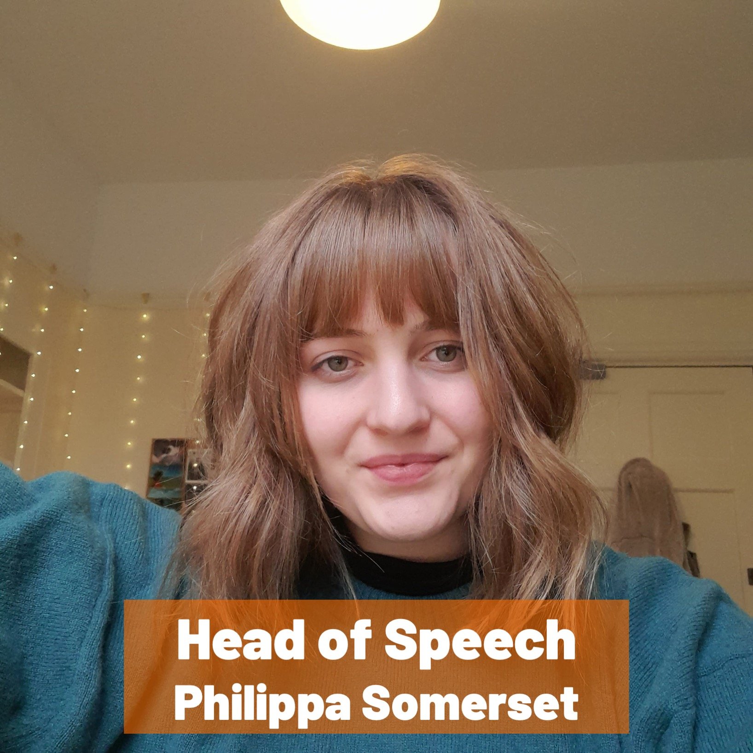
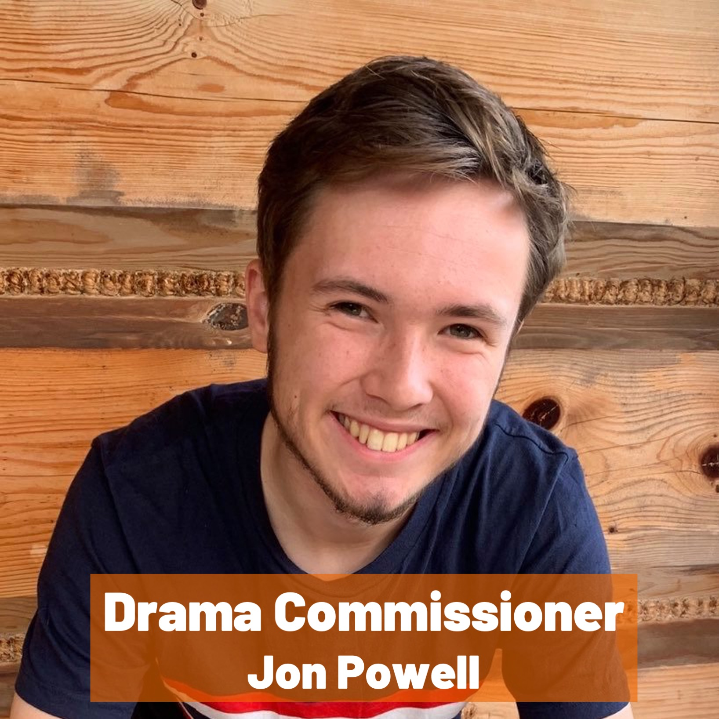
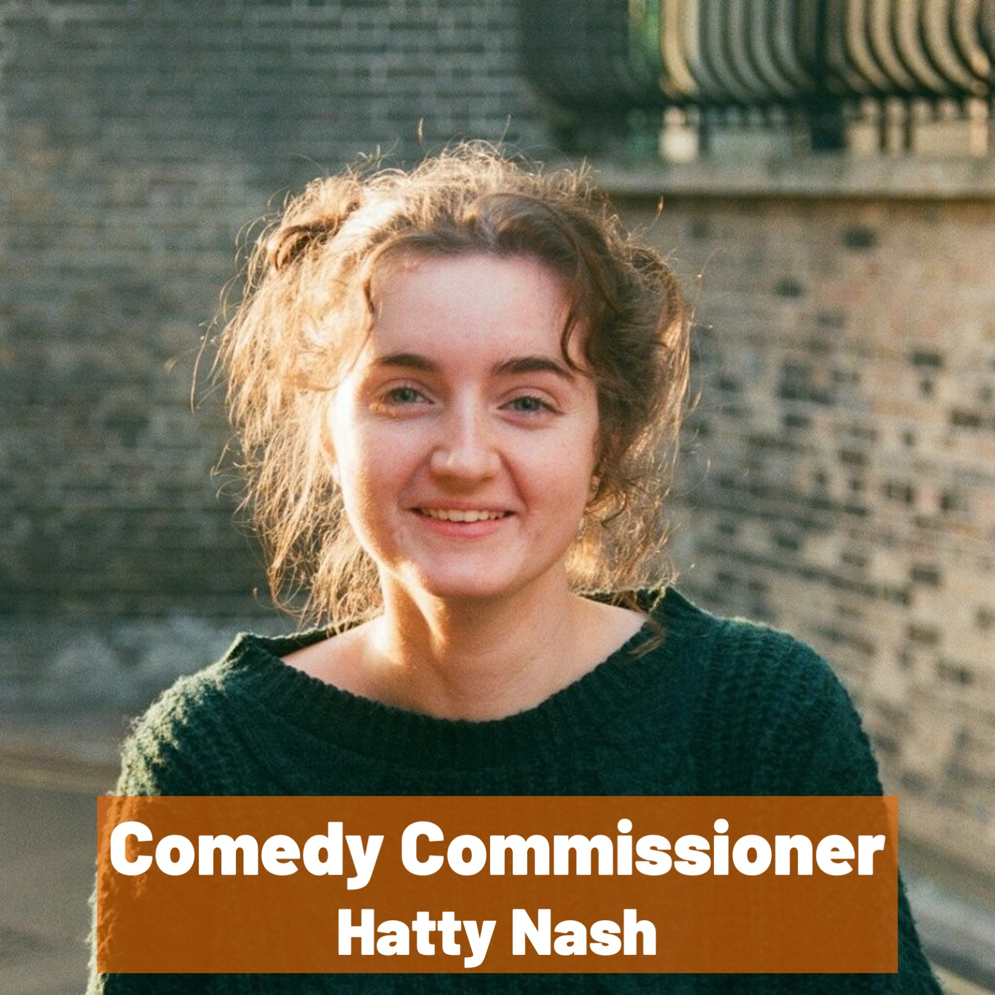

Slide 9
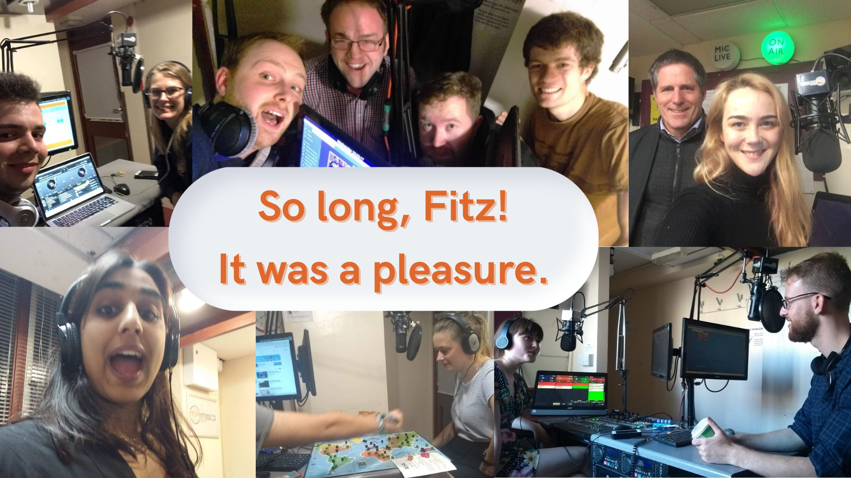

Slide 11
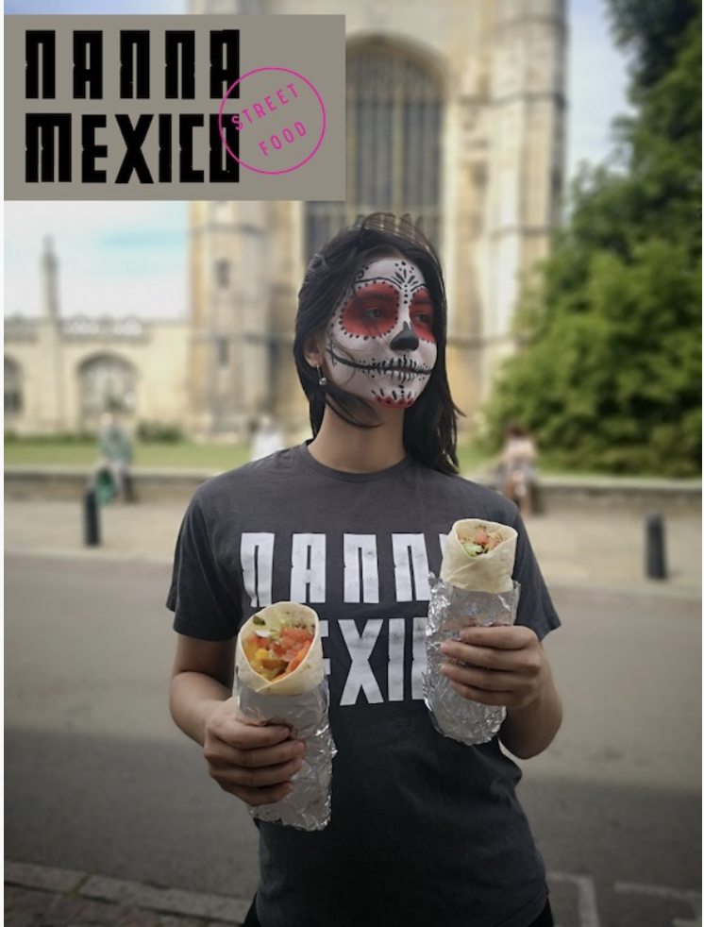
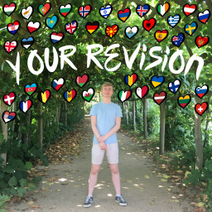
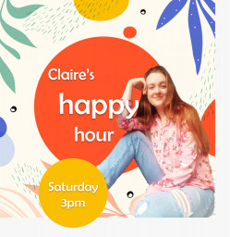

Slide 12
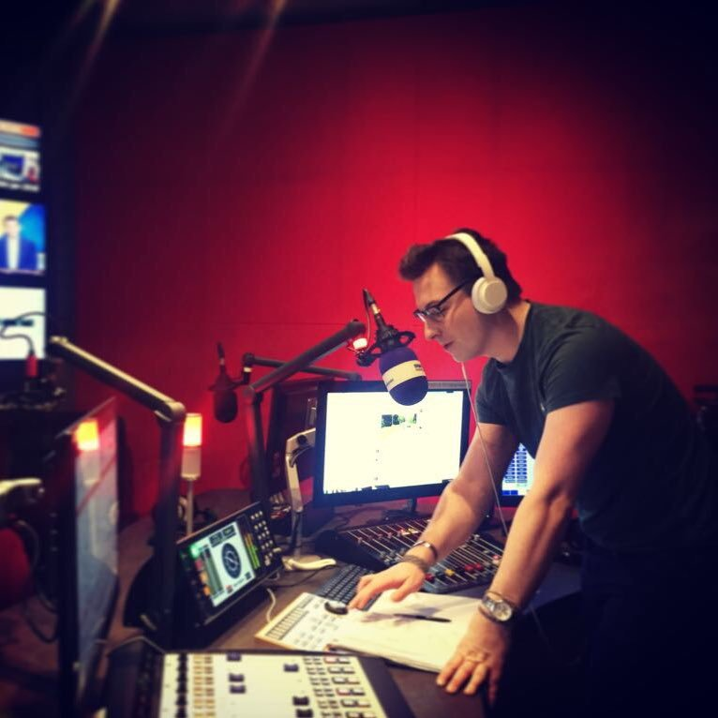
Speed Friending
Chris Berrow:
Talk and Q&A
The SRAs
Christmas Awards

Slide 13
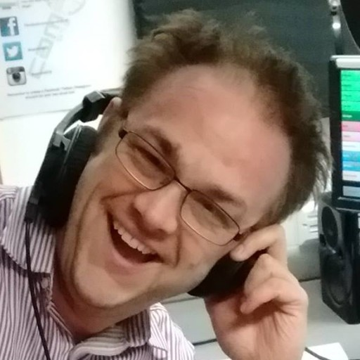
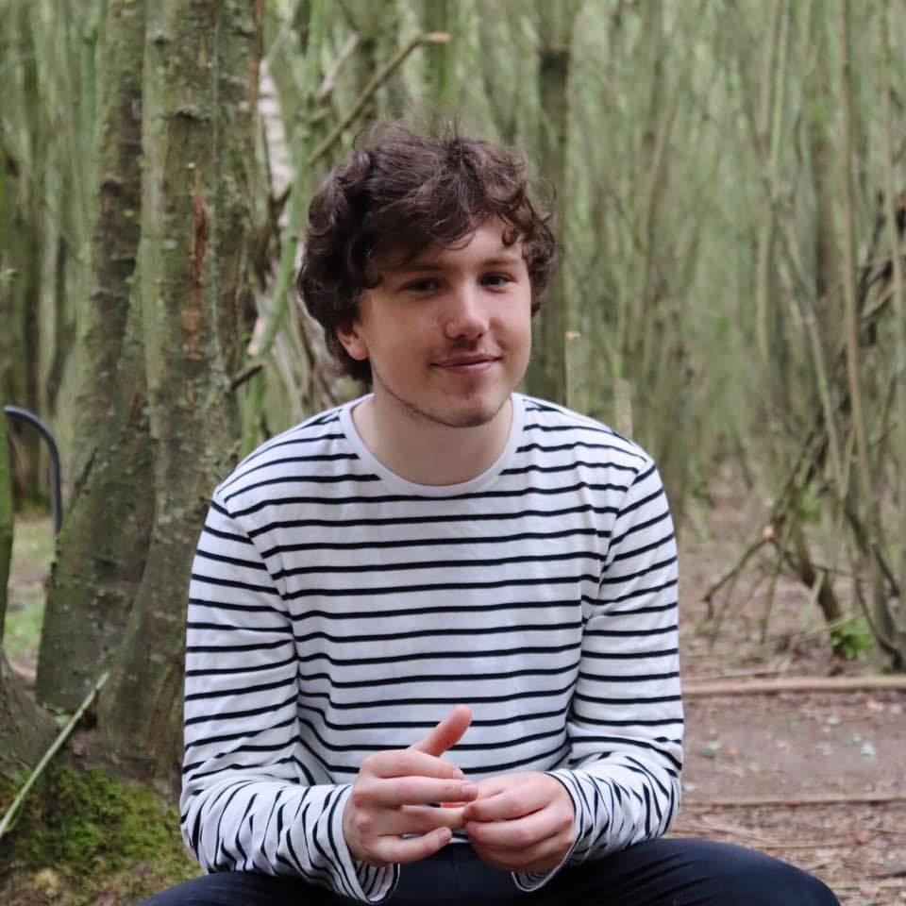
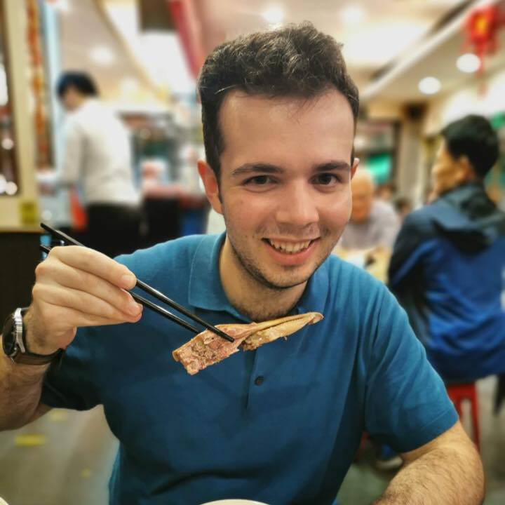
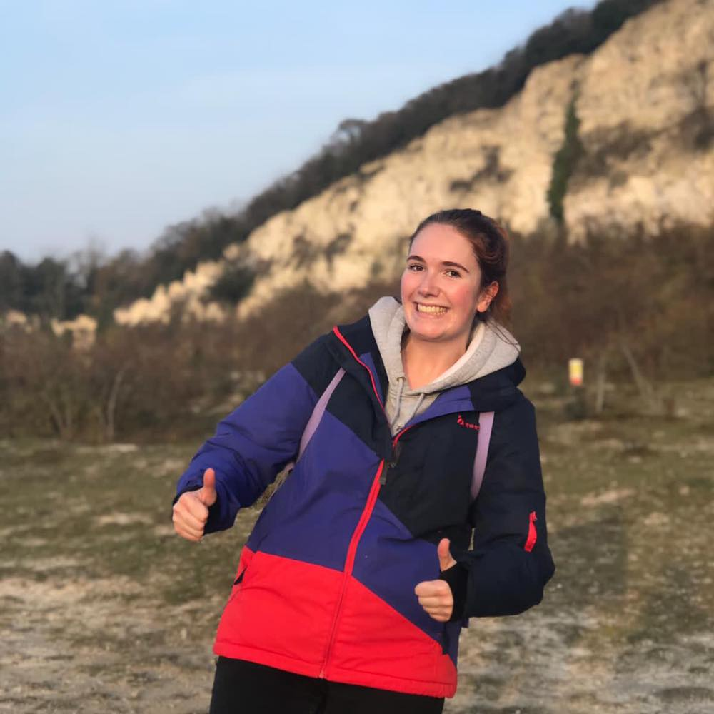
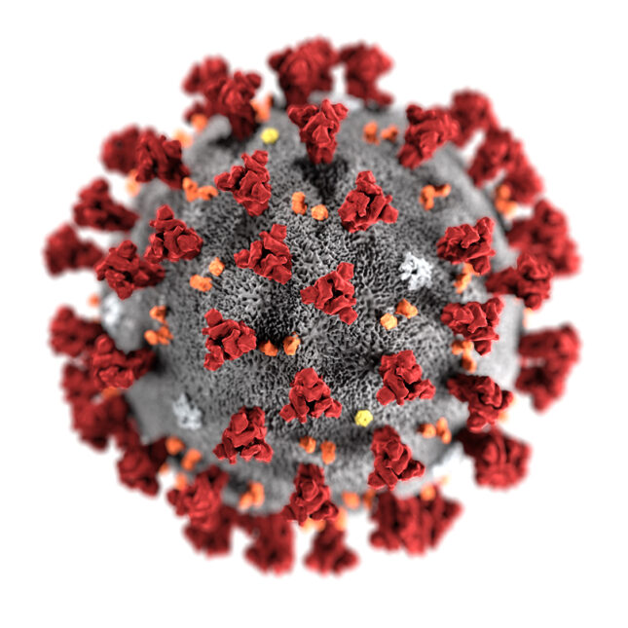
Sam Holloway
Jake Boud
Oliver Harris
Lucie Richardson
Louis Davies
Matias Vanhanen
Jacob Baldwin
Andrew Ying
Gareth Scourfield
Eliza Pepper
Uma Suri
Cicely Norman
Claire Coates
Philippa Somerset
Jonathan Powell
Hatty Nash
Merel van Schooten
Cameron White
George Richmond
Matt Green
Simon Ruggles
you
for
EVERYONE who transitioned to broadcasting from home
EVERYONE who made any content for Cam FM this year
EVERYONE who came along to our online events
ARU and Fitzwilliam College
Thank
not you
all
your
help
this
year

